Slide 1


App
App
App
App
App
App
Specialized
Applications
Open Interface
Windows
Linux
Mac
OS
Specialized
OS
or
or
Open Interface
Specialized
Hardware
Microprocessors

Slide 2
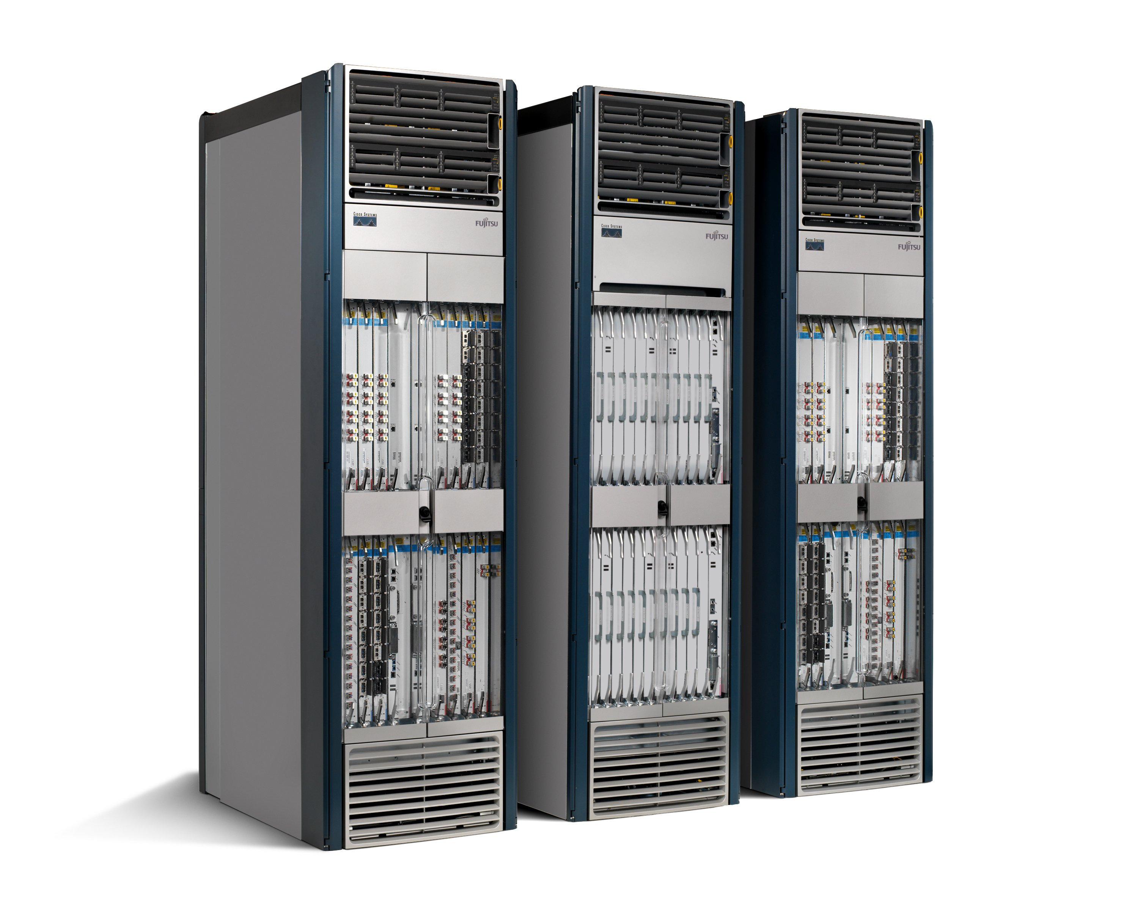
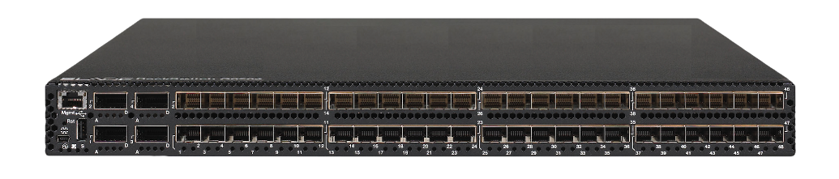
App
App
App
App
App
App
Specialized
Applications
Open Interface
Network
OS
Network
OS
Network
OS
Specialized
OS
or
or
Open Interface
Specialized
Hardware
Merchant Silicon
Switching Chips

Slide 3
MAC
Header
IP
Header
TCP/UDP
Header
Dst
Addr
Src
Addr
Type
…
Proto
…
Src
Addr
Dst
Addr
…
Src
Port
Dst
Port
…
… Payload …
Type
Ctl
VLAN ID
Optional 802.1Q VLAN Tag

Slide 4
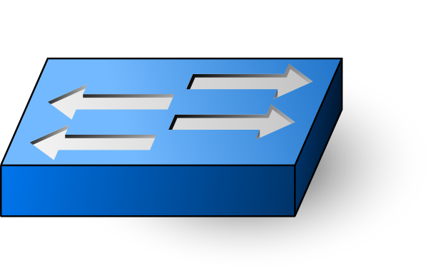

Flow Table
<match, action>
.
.
.
OpenFlow
Switch
Controller
OpenFlow
Protocol
TLS

Slide 5
Control
App
Control
App
Control
App
Control
App
. . .
Network OS
Global
Network
Map
Control Plane
Data Plane
Flow Rules

Slide 6
Outer
MAC
Header
Outer
IP
Header
Outer
UDP
Header
VXLAN
Header
Inner
MAC
Header
… Payload …
Flags
Reserved
VNI
Reserved

Slide 7
OpenFlow Switch
Packet
In
Table
0
Packet +
Metadata
Table
1
Table
n
Execute
Action
Set
Packet
Out
. . .
Packet
Action
Set = {}
Action
Set
Action
Set

Slide 8
Control
App
Control
App
Control
App
Trellis
gRPC
Network Operating System
gNMI + gNOI + FlowObjectives
API
forward.p4
arch.p4
ONOS
P4
Compiler
gRPC
Programmable Switch
gNMI + gNOI + P4Runtime/OpenFlow
API
Switch OS
Stratum + ONL
Merchant Silicon
Tofino (Barefoot),
Tomahawk (Broadcom)

Slide 9



Trellis
Trellis
Trellis
Trellis
Trellis
Trellis
Trellis
Trellis
ONOS
P4Runtime Contract
Stratum OS
Stratum OS
Field
Office
Stratum OS
Stratum OS
Stratum OS
Stratum OS
Internet
Stratum OS
Stratum OS
Central
Office
Stratum OS
Metro/Core
Router
Base
Stations

Slide 10
Management Network
Bare-Metal Switch
Network Processing Unit
Forwarding Pipeline
CPU
(Control)
PCIe
SRAM (Packet Buffers)
SFI
48x40G SFP+
(Ports 1~48)
. . .
Data Network

Slide 11
Programmable
Parser
Programmable Match-Action Pipeline
Programmable
Deparser
Memory
ALU
Memory
ALU
Memory
ALU
Memory
ALU
Memory
ALU
Memory
ALU
Memory
ALU
Memory
ALU
Memory
ALU
Memory
ALU
Memory
ALU
Memory
ALU
Memory
ALU
Memory
ALU
Memory
ALU
Memory
ALU
Memory
ALU
Memory
ALU
Memory
ALU
Memory
ALU
Memory
ALU
Memory
ALU
Memory
ALU
Memory
ALU

Slide 12
forward.p4
IPv4
L2
ACL
IPv6
P4 Compiler: Allocates resources
to realize the pipeline
Programmable
Parser
Programmable Match-Action Pipeline
Programmable
Deparser
L2
IPv4
IPv4
ACL
Memory
ALU
Memory
ALU
Memory
ALU
Memory
ALU
Memory
ALU
Memory
ALU
Memory
ALU
Memory
ALU
Memory
ALU
Memory
ALU
Memory
ALU
Memory
ALU
ALU
ALU
ALU
IPv6
Memory
Memory
Memory
Memory
ALU
Memory
ALU
Memory
ALU
Memory
ALU
Memory
ALU
Memory
ALU
Memory
ALU
Memory
ALU
Memory
ALU

Slide 13
forward.p4
Traffic Manager
Packets:
Queue
Replicate
Schedule
Fixed Function
Fixed function
Traffic Manager
arch.p4

Slide 14
INDIRECT
Phy
Port
SELECT
MPLS Label Group
Multicast
Routing Table
L3 ECMP Group
Ingress
Port
Table
MPLS Label Group
INDIRECT
Unicast Routing Table
L3 Unicast Grouop
VLAN
Table
Termin-ation MAC
Table
ACL Policy Table
INDIRECT
L2 Interface Group
Phy Port
ALL
MPLS Table
L2 Flood Group
L2 Interface Group
VLAN 1
Table
MPLS
L2 Port
Table
Phy Port
ALL
Bridging Table
L3 Multicast Group

Slide 15
Controller
Off-Switch
OF-Agent
(Indigo)
OF-DPA
On-Switch
Broadcom SDK
ASIC

Slide 16
Controller
Logical
Pipeline
P4 Compiler
maps from
Logical to
Physical
Physical
Pipeline
ASIC 1
ASIC 2

Slide 17
P4
Program
P4Runtime
gNMI
gNOI
Stratum
Interface Broker
P4
Compiler
Table Manager
Node
Chassis Manager
Chip Abstraction Managers
Platform Manager
ONL
Switch SDK (Driver)
Platform API
Switch Chip(s)
Peripheral(s)

Slide 18
forward.p4
IPv4
L2
ACL
Controller
IPv6
P4Runtime Client
P4 Compiler
p4runtime.proto
Compiler Frontend
arch.p4
forward.p4info
Switch OS
Tomahawk
Backend
Tofino
Backend
P4Runtime Server
ASIC SDK
bcm_forward.bin
bf_forward.bin
Switch ASIC

Slide 19
Control App
Control App
Control App
Control App
Network OS
VM
…
VM
VM
…
VM
vS
Switch OS
Switch OS
Switch OS
vS
NIC
NIC
End Host
End Host

Slide 20
Spine
Spine
Spine
Leaf
Leaf
Leaf
Leaf

Slide 21
Spine
Spine
Passive Optical
Network
Leaf
Leaf
Leaf
…
…
OLT
…
OLT
OLT
…
…

Slide 22
Traffic Manager
Packets:
Queue
Replicate
Schedule
Fixed Function
Fixed function
Traffic Manager
Parser
Ingresss Match+Action Pipeline
/ Checksum Verification
Traffic
Manager
Egresss Match+Action Pipeline
/ Checksum Update
Deparser

Slide 23
switch.p4
ofdpa.c
ofdpa.pdf
(spec)
ofdpa.p4
sai.c
sai.pdf
(spec)
sai.p4
Pipeline
Definition
ofdpa.h
sai-brcm.h
Compiles
Abstracts
Compiles
Abstracts
Compiles
tna.p4
(arch)
Broadcom SDK
brcm.p4
(arch)
Broadcom SDK
xxx.p4
(arch)
Vendor
SDK
Barefoot P4 Compiler
Broadcom P4 Compiler
XXX P4
Compiler
Abstracts
Abstracts
Abstracts
Abstracts
Abstracts
Switching
Chip
Tofino ASIC
Tomahawk ASIC
Tomahawk ASIC
Tomahawk ASIC
XXX ASIC

Slide 24
Routing Table
(RIB)
Control Plane
Forwarding Table
(FIB)
Data Plane

Slide 25

model.yang
model.go, model.cc, model.java. ...
YANG Compiler
(e.g. ygot)
gNMI Client
Language-Specific
Compiler
(e.g. go, gcc, javac)
Model-Independent
Runtime API, represented
as a ProtoBuf
gNMI Server

Slide 26
Apps
Apps
Control Apps
Northbound APIs
Topology
FlowRule
FlowObjective
gNMI
gNOI
...
ONOS
Distributed Core
OVS
BMv2
Barefoot
Cavium
Mellanox
Ciena
Cisco
Corsa
Southbound Plugins
Device-specific Drivers
Shared Protocol Libraries
Fujitsu
HP
Huawei
Juniper
Lumentum
Microsemi
Polatis
...
OpenFlow
P4Runtime
gNMI
...

Slide 27
Abstract
Intents
Flow Objective
OF-DPA Pipeline
Single Table Pipeline
P4-Defined
Pipeline
Multiple Pipelines
Flow Rule
OpenFlow
P4Runtime
Netconf
...
Multiple Drivers
Concrete

Slide 28
role spec
Zero-Touch Provisioning
App
Topology
FlowRule
FlowObjective
gNMI
gNOI
ONOS
Software, Certs, Config, Pipeline

Slide 29
Control App
Event
Listener
Register
Topology Event
Topology Service
(ONOS)
Event
Listener
Link Event
Register
Device Event
Link Service
(ONOS)
Device Service
(ONOS)
Map
Listener
Map
Listener
Register
Map
Event
Register
Map
Event
Atomix
Distributed Map
Distributed Map
Map(k,v)
Map(k,v)

Slide 30
Control App
Control App
Control App
Control App
Contract
Generation
&
Analysis
Control
Network OS
Dataplane
VM
…
VM
VM
…
VM
vS
Switch OS
Switch OS
Switch OS
vS
NIC
NIC
End Host
End Host
Fine-grain, In-band Measurement

Slide 31
Spine 1
Spine 2
ECMP
Groups
Leaf 1
Leaf 3
Leaf 2
Paired
Leaves
(Dual ToRs)
Leaf 4
Server
Server
Linux Bonding
Active-Active
Dual-Homed
Servers
External
Routers

Slide 32
Match: MPLS_Label = 102
Match: MPLS_Label = 102
Spine 1
(103)
Spine 2
(104)
Pop Label
Pop Label
Push
102
IP
IP
Match:
DST_IP = 10.0.2.0/24
Match:
DST_IP = 10.0.2.1/32
Leaf 1
(101)
Leaf 2
(102)
IP
IP
10.0.1.1/24
10.0.2.1/24
Host 1
Host 2

Slide 33
Path Service
Host
Service
Topology Service
Map
Host Location
Provider
Link
Service
Device
Service
Map
Map
Packet Service

Slide 34
Human
Operator
ZTP Application
Network Config
Service
Topology Service
Link
Service
Device
Service
Map
Map

Slide 35
ONOS Applications
… and Core Services …
SBI
Framework
Device
Provider
Host
Provider
Link
Provider
Open
Flow
gNMI
…
… Network Devices …

Slide 36
Control
Applications
Service Management
and
Orchestration
Link Aggregation
Interference Mgmt
Handover Control
Load Balancing
…
C1 Server
A1 Server
ONOS RIC:
RAN
Intelligent
Controller
Northbound I/O Controller
Control
Service
Telemetry
Service
Topology
Service
K/V
TS
DB
Southbound I/O Controller
E2 Client
E2 Client
E2 Client
E2 Client
RAN Elements

Slide 37
Phase 1
Network owners take control of their software
Phase 3
Networks managed by verifiable closed loop control
2010
2020
2030
Phase 2
Network owners take control of packet processing

Slide 38

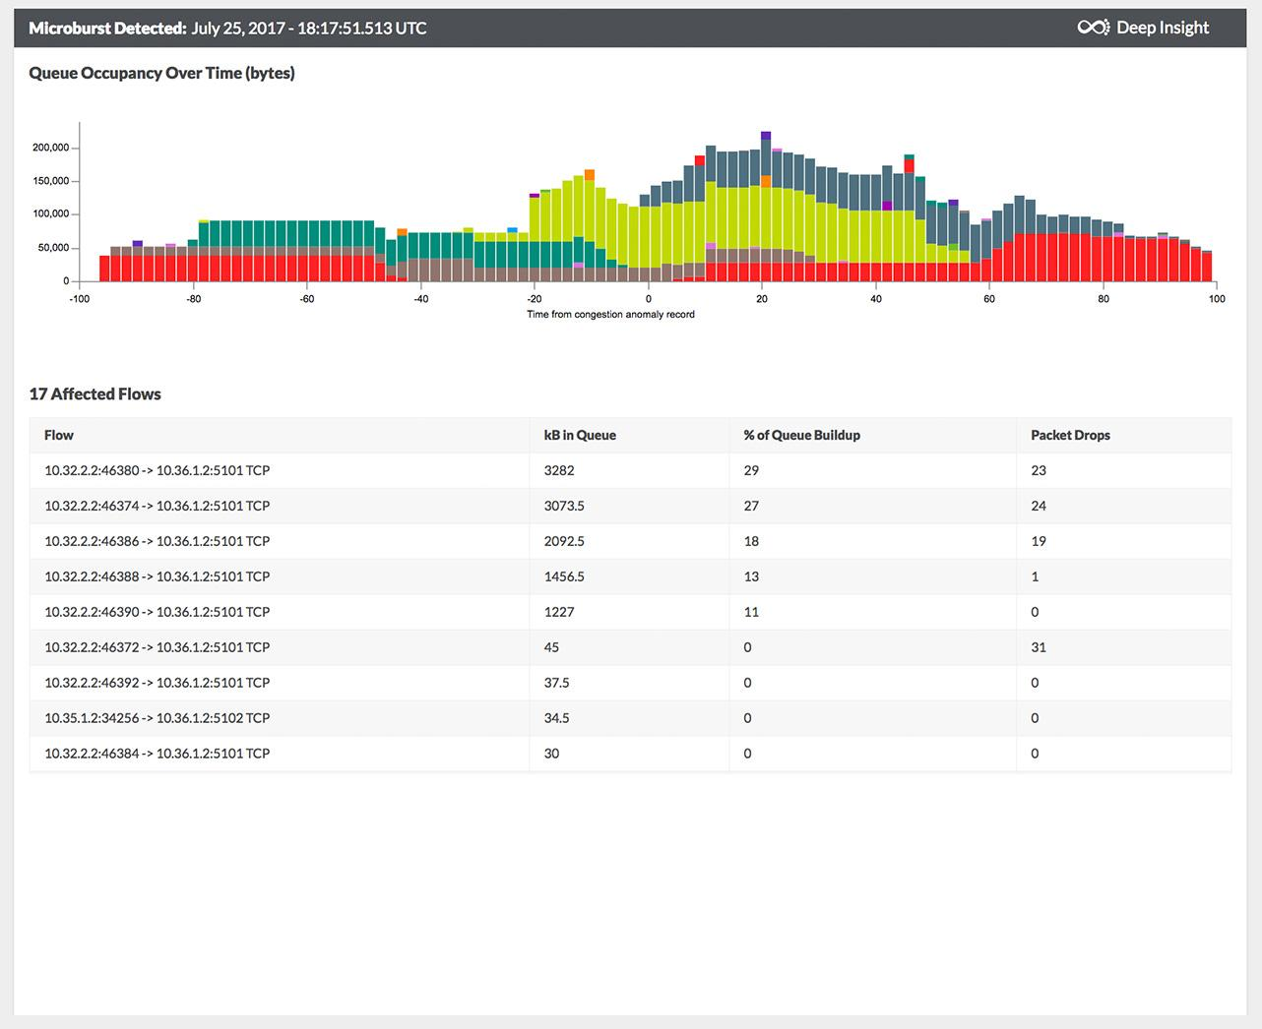
Add Switch ID, arrival time, departure, queue delay, etc.
Generate report with switch metadata
Header
Header
Metadata S1
Metadata S1
Metadata S2
Header
Payload
S2
Payload
Header
Payload
Payload
S1
S3
S5
Metadata S1
Metadata S2
S4
Metadata S5
Log, analyze, replay, visualize

Slide 39
Filter on “Switch-Port, MAC-Addr, VLAN, IP-Addr”
Flow Objective Service
Vendor 1 Pipeliner
Vendor 2 Pipeliner
OpenFlow 1.3
Flow Rules
Vendor 1 Pipeline
Vendor 2 Pipeline
T0
mac
T2
port-
vlan
T6
ip
T0
port
T1
vlan
T2
mac
T4
ip

Slide 40
In-port + VLAN Filtering Table
Drop
Filtering
Permit with Internal VLAN
Forwarding Classifier
Bridging
IPv4 Routing
IPv6 Routing
MPLS
Forwarding
ACL
Drop or pass up to ONOS
Next ID Mapping
Next
Hashed (ECMP)
Multicast
...
Next VLAN

Slide 41
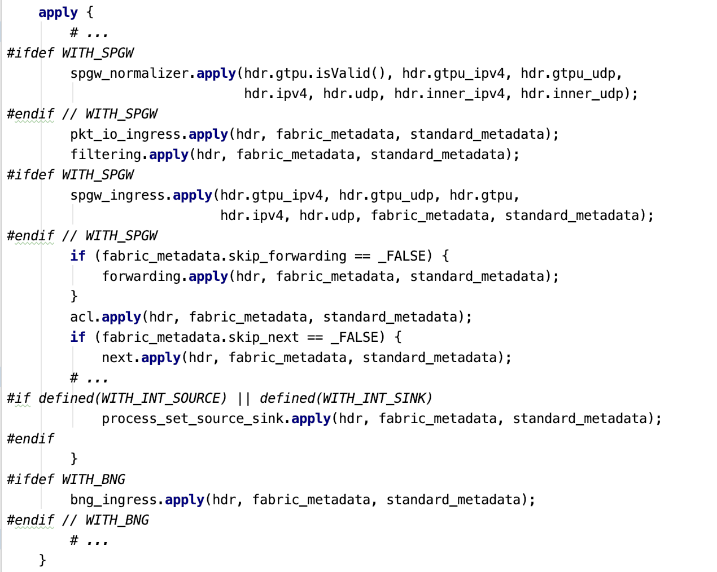
Optional Features
Basic Functionality
SPGW
Filtering
Forwarding
Next
INT
BNG

Slide 42
ONOS
Instance 1
ONOS
Instance n
Apps
Apps
Services
Atomix
Maps
Raft
Atomix
Maps
Services
Drivers
Algorithm
Drivers
Protocols
Protocols

Slide 43
Network Policies
SD-WAN Controller
Cloud Services
Corporate
Datacenter
Branch
Overlay Tunnel
SD-WAN Edge
Main Office

